Slide 1
Scaling Multi-Agent Reinforcement Learning with Selective Parameter Sharing
Du Xiao - December, 10th, 2021

Slide 2
Motivation
Due to the limited bandwidth, such frequent communication will cause severe bottleneck for the training acceleration.
Some methods（Quantized Data Parallelism） overlook the effects of compression on the model performance such that they either suffer from a low compression ratio or an accuracy drop.
To reduce communication cost and preserve the accuracy at the same time

Slide 3
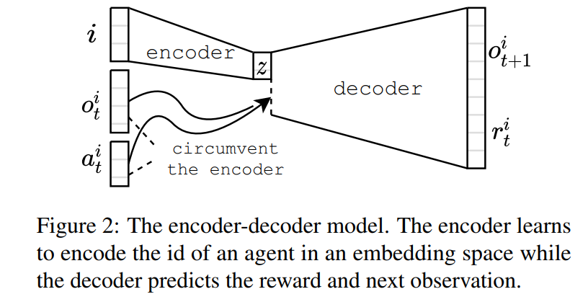
Model - Variational Autoencoders

Slide 4
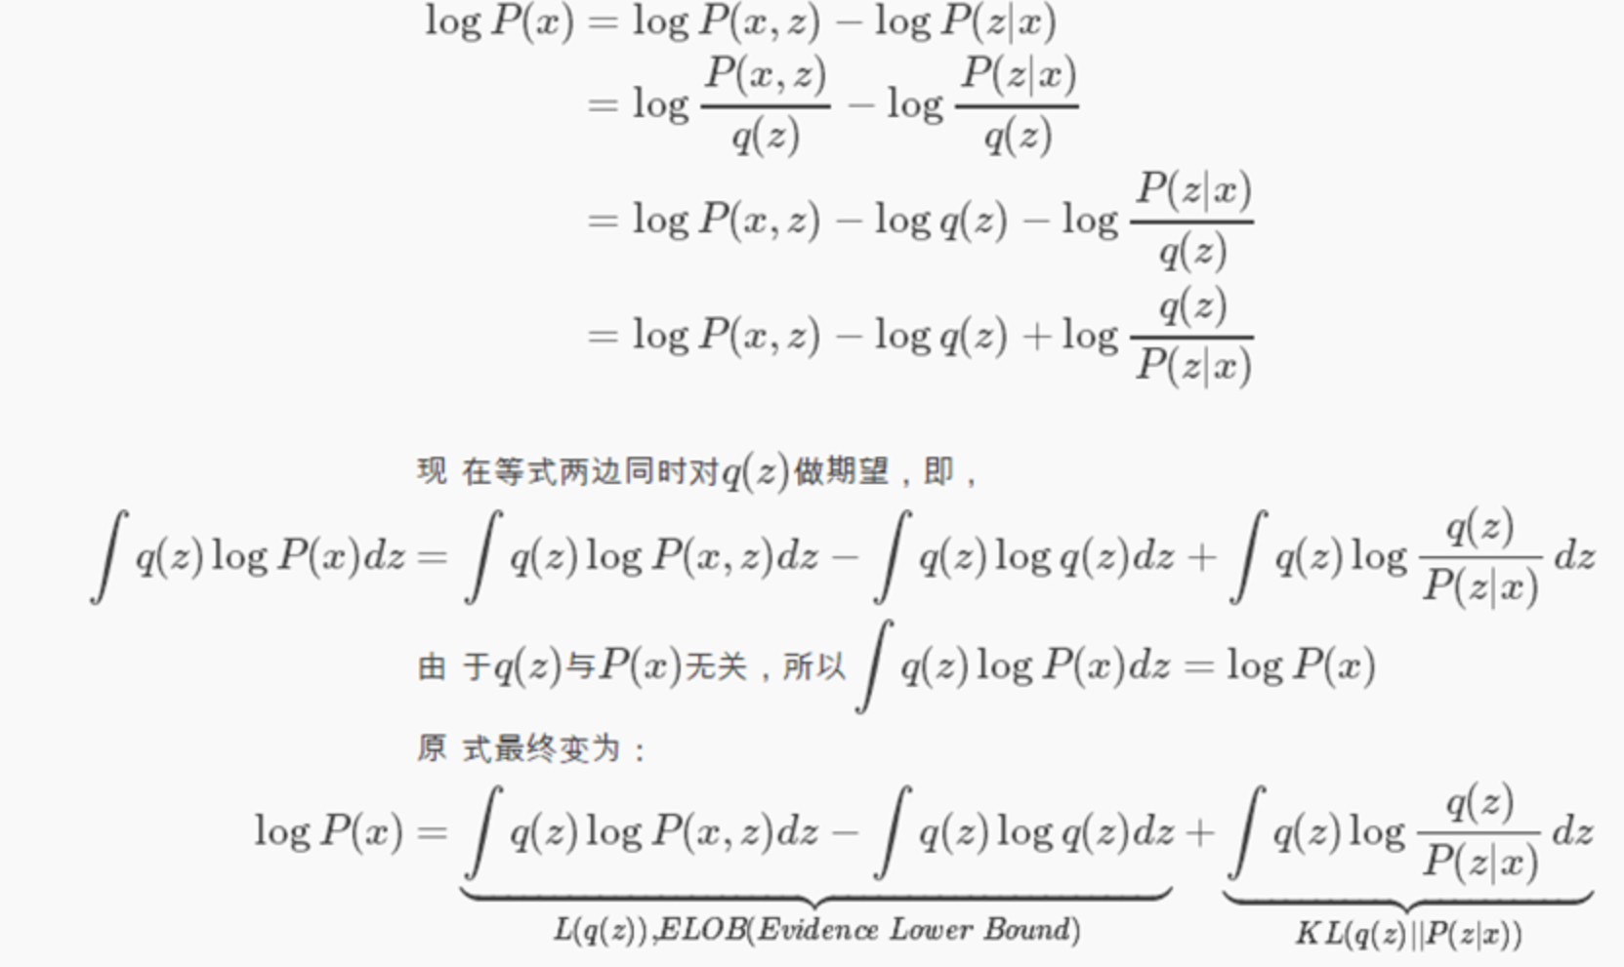
Variational inference

Slide 5

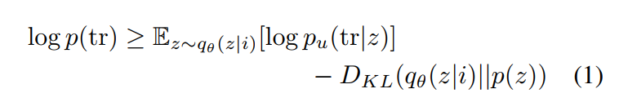
Mathematical Model
Optimise objective:
equivalent to minimize ELBO:

Slide 6
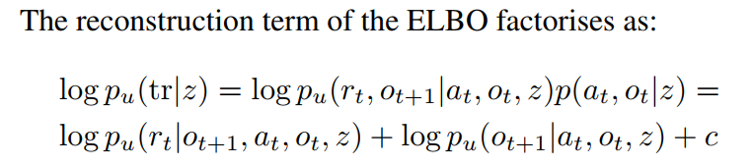
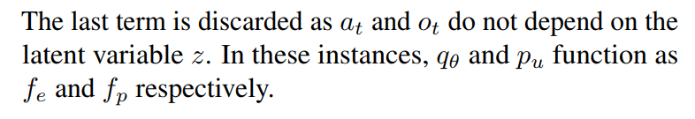
Mathematical Model

Slide 7
Evaluation
baseline:
(1) No Parameter Sharing (NoPS)
(2) Full Parameter Sharing (FuPS)
(3) Full Parameter Sharing with index (FuPS+id)

Slide 8
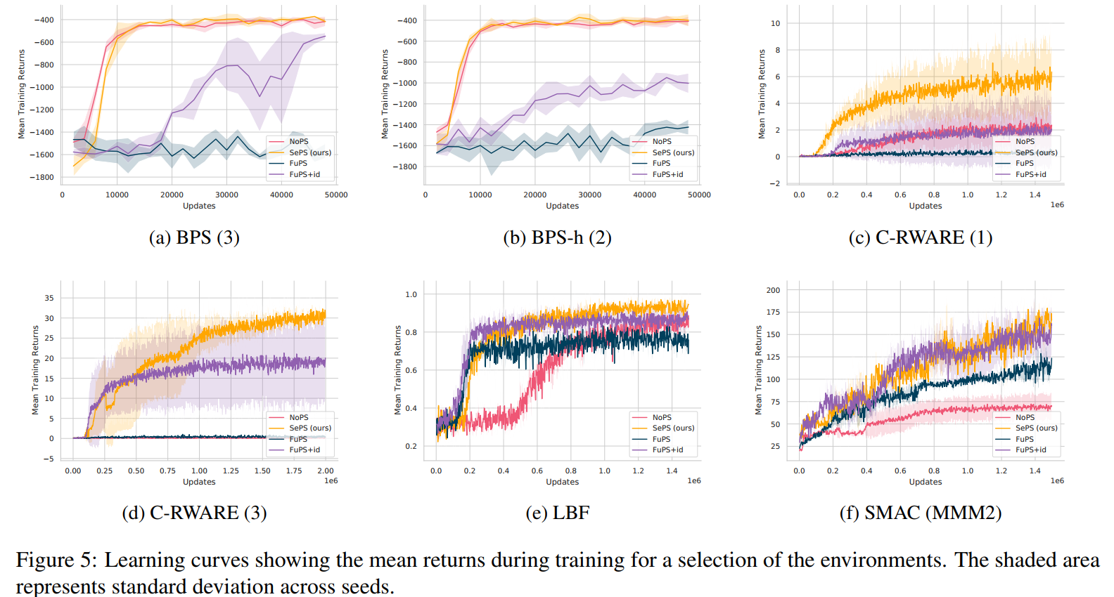
Convergence performance

Slide 9
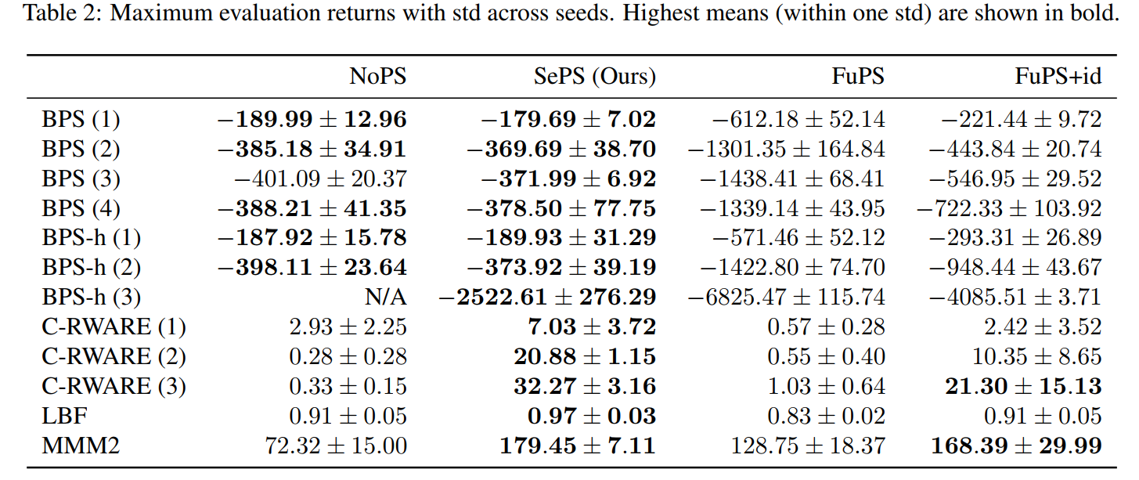
Reward

Slide 10
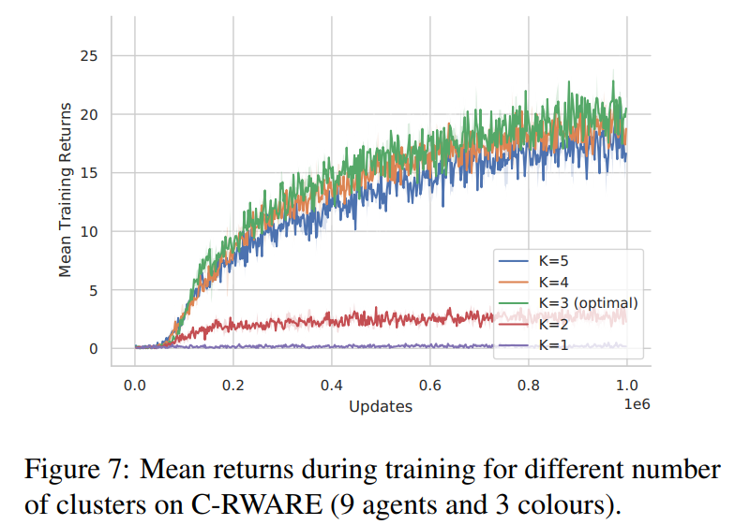
culster analysis

Slide 11
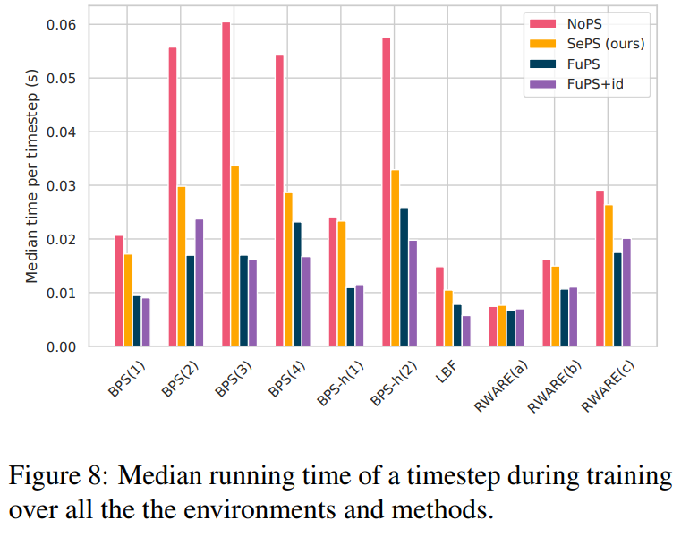
Running time performance

